Slide 2
Image Filtering

Slide 3
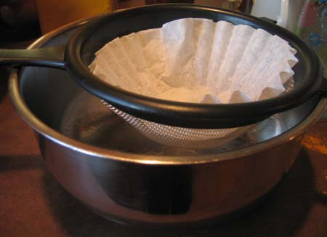
Image Filtering

Slide 4
Image filtering
Image filtering is used to compress or enhance some image features.
Normally used as a pre-processing step to achieve better results.
Filters can be spatial or frequency.
Through image filtering, we achieve the following operations:
Smoothing
Sharpening
Edge Enhancement
Image filtering is normally achieved using kernel and the process is called convolution.

Slide 5
Filters
Filtering
Form a new image whose pixels are a combination of the original pixels
Why?
To get useful information from images
E.g., extract edges or contours (to understand shape)
To enhance the image
E.g., to blur to remove noise
E.g., to sharpen to “enhance image”

Slide 6
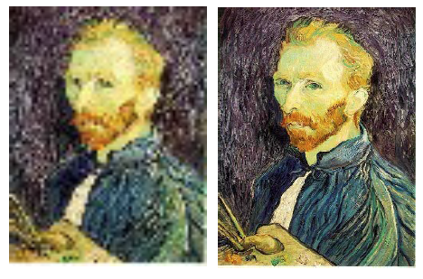
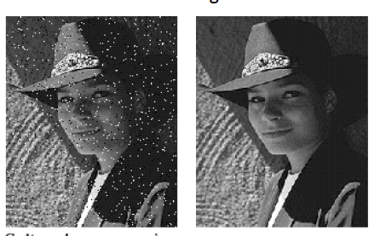
Super-resolution
Noise reduction

Slide 7
Image denoising

Slide 8
Why would images have noise?
Sensor noise
Sensors count photons: noise in count
Dead pixels
Old photographs
…

Slide 9
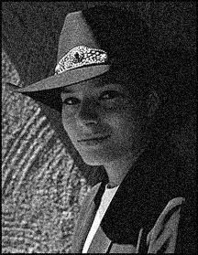
An assumption about noise
Let us assume noise at a pixel is
independent of other pixels
distributed according to a Gaussian distribution
i.e., low noise values are more likely than high noise values
“grainy images”

Slide 10
Noise reduction
Nearby pixels are likely to belong to same object
thus likely to have similar color
Replace each pixel by average of neighbors

Slide 11
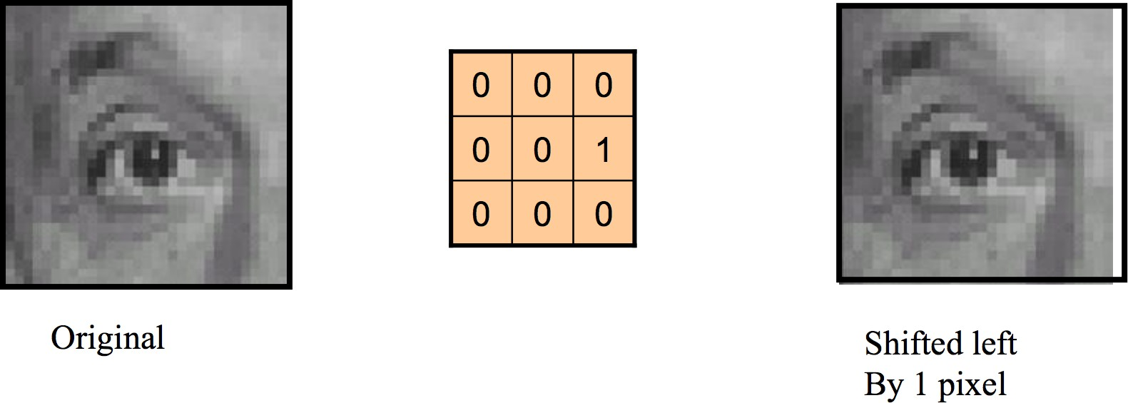
FILTERING
Linear filters combine each pixel with its neighbours.
Source: https://cs.brown.edu/courses/csci1430/lectures/2019Spring_01_Introduction.pdf

Slide 12

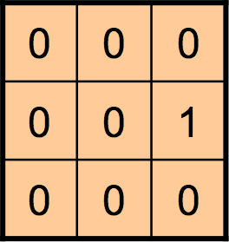
FILTERING

Slide 13
FILTERING
180 90 0
180 90 0
180 90 0
0 x 180 + 0 x 90 + 0 x 0
+ 0 x 180 + 0 x 90 + 1 x 0
+ 0 x 180 + 0 x 90 + 0 x 0
= 0

Slide 14
FILTERING
180 90 0
180 0
0
180 90 0
0 x 180 + 0 x 90 + 0 x 0
+ 0 x 180 + 0 x 90 + 1 x 0
+ 0 x 180 + 0 x 90 + 0 x 0
= 0

Slide 15
FILTERING
90 0 255
90 0 255
90 0 255
0 x 90 + 0 x 0 + 0 x 255
+ 0 x 90 + 0 x 0 + 1 x 255
+ 0 x 90 + 0 x 0 + 0 x 255
= 255

Slide 16
FILTERING
90 0 255
90 255 255
90 0 255
0 x 90 + 0 x 0 + 0 x 255
+ 0 x 90 + 0 x 0 + 1 x 255
+ 0 x 90 + 0 x 0 + 0 x 255
= 255

Slide 17
FILTERING
180 90 0 255
180 0 255 255
180 90 0 255

Slide 18

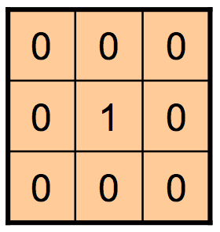
FILTERING
What filter would leave the image unchanged?

Slide 19
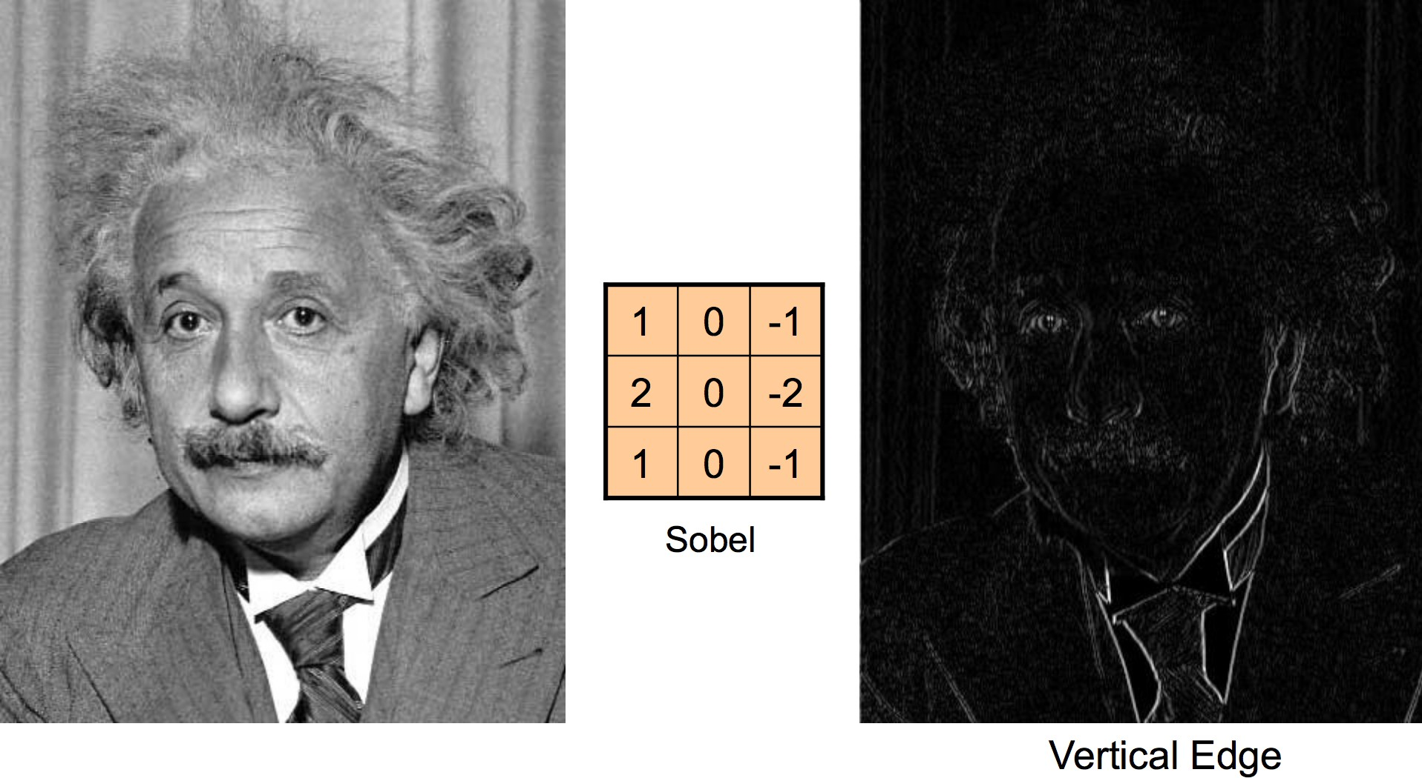
FILTERING
Source: https://cs.brown.edu/courses/csci1430/lectures/2019Spring_01_Introduction.pdf

Slide 20
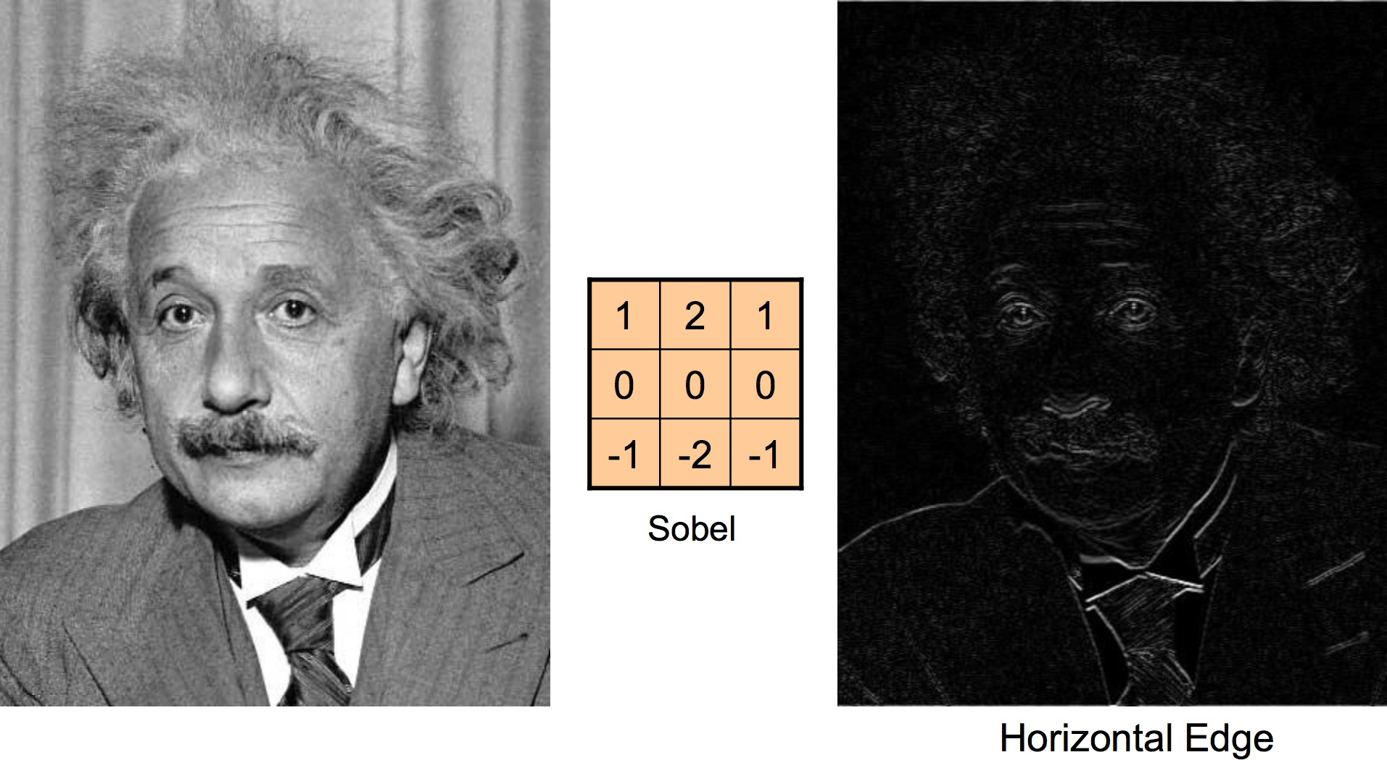
FILTERING
Source: https://cs.brown.edu/courses/csci1430/lectures/2019Spring_01_Introduction.pdf

Slide 21
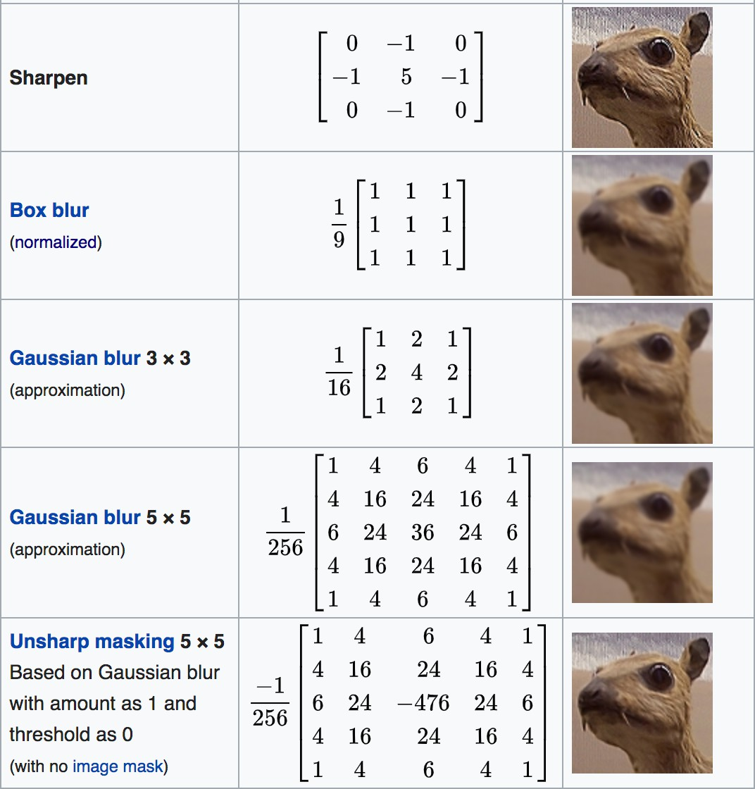
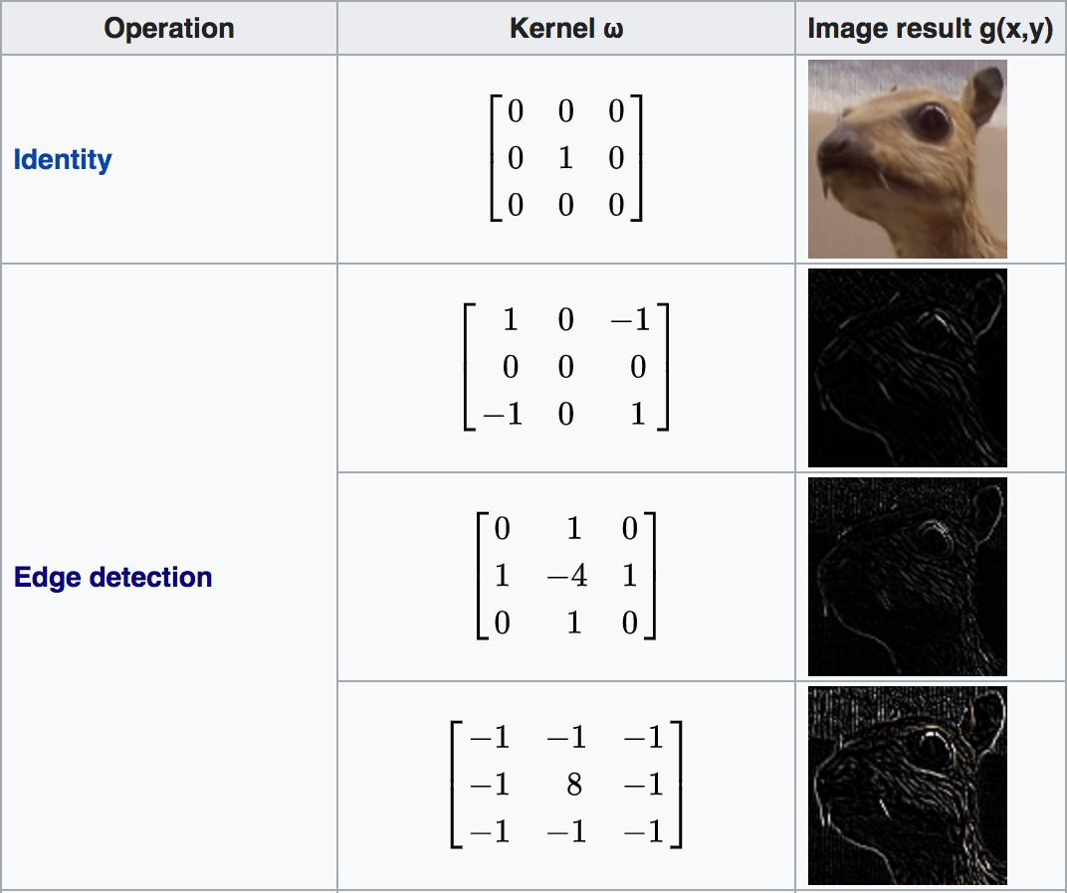
FILTERING
Source: https://en.wikipedia.org/wiki/Kernel_%28image_processing%29

Slide 22
Mean filtering
0 | 0 | 0 | 0 | 0 | 0 | 0 | 0 | 0 | 0
0 | 0 | 0 | 10 | 10 | 10 | 0 | 0 | 0 | 0
0 | 0 | 10 | 20 | 20 | 20 | 10 | 40 | 0 | 0
0 | 10 | 20 | 30 | 0 | 20 | 10 | 0 | 0 | 0
0 | 10 | 0 | 30 | 40 | 30 | 20 | 10 | 0 | 0
0 | 10 | 20 | 30 | 40 | 30 | 20 | 10 | 0 | 0
0 | 10 | 20 | 10 | 40 | 30 | 20 | 10 | 0 | 0
0 | 10 | 20 | 30 | 30 | 20 | 10 | 0 | 0 | 0
0 | 0 | 10 | 20 | 20 | 0 | 10 | 0 | 20 | 0
0 | 0 | 0 | 10 | 10 | 10 | 0 | 0 | 0 | 0
0 | 0 | 0 | 0 | 0 | 0 | 0 | 0 | 0 | 0
0 | 1 | 0 | 0 | 0 | 0 | 0 | 0 | 0 | 0
0 | 0 | 0 | 0 | 0 | 0 | 0 | 0 | 0 | 0
0 | 0 | 0 | 0 | 0 | 0 | 0 | 0 | 0 | 0
0 | 0 | 0 | 0 | 0 | 0 | 0 | 0 | 0 | 0
0 | 0 | 0 | 0 | 0 | 0 | 0 | 0 | 0 | 0
0 | 0 | 0 | 0 | 0 | 0 | 0 | 0 | 0 | 0
0 | 0 | 0 | 0 | 0 | 0 | 0 | 0 | 0 | 0
0 | 0 | 0 | 0 | 0 | 0 | 0 | 0 | 0 | 0
0 | 0 | 0 | 0 | 0 | 0 | 0 | 0 | 0 | 0
(0 + 0 + 0 + 0 + 0 + 0 + 0 + 0 + 10)/9 = 1.11

Slide 23
Mean filtering
0 | 0 | 0 | 0 | 0 | 0 | 0 | 0 | 0 | 0
0 | 0 | 0 | 10 | 10 | 10 | 0 | 0 | 0 | 0
0 | 0 | 10 | 20 | 20 | 20 | 10 | 40 | 0 | 0
0 | 10 | 20 | 30 | 0 | 20 | 10 | 0 | 0 | 0
0 | 10 | 0 | 30 | 40 | 30 | 20 | 10 | 0 | 0
0 | 10 | 20 | 30 | 40 | 30 | 20 | 10 | 0 | 0
0 | 10 | 20 | 10 | 40 | 30 | 20 | 10 | 0 | 0
0 | 10 | 20 | 30 | 30 | 20 | 10 | 0 | 0 | 0
0 | 0 | 10 | 20 | 20 | 0 | 10 | 0 | 20 | 0
0 | 0 | 0 | 10 | 10 | 10 | 0 | 0 | 0 | 0
0 | 0 | 0 | 0 | 0 | 0 | 0 | 0 | 0 | 0
0 | 1 | 4 | 0 | 0 | 0 | 0 | 0 | 0 | 0
0 | 0 | 0 | 0 | 0 | 0 | 0 | 0 | 0 | 0
0 | 0 | 0 | 0 | 0 | 0 | 0 | 0 | 0 | 0
0 | 0 | 0 | 0 | 0 | 0 | 0 | 0 | 0 | 0
0 | 0 | 0 | 0 | 0 | 0 | 0 | 0 | 0 | 0
0 | 0 | 0 | 0 | 0 | 0 | 0 | 0 | 0 | 0
0 | 0 | 0 | 0 | 0 | 0 | 0 | 0 | 0 | 0
0 | 0 | 0 | 0 | 0 | 0 | 0 | 0 | 0 | 0
0 | 0 | 0 | 0 | 0 | 0 | 0 | 0 | 0 | 0
(0 + 0 + 0 + 0 + 0 + 10 + 0 + 10 + 20)/9 = 4.44

Slide 24
Mean filtering
0 | 0 | 0 | 0 | 0 | 0 | 0 | 0 | 0 | 0
0 | 0 | 0 | 10 | 10 | 10 | 0 | 0 | 0 | 0
0 | 0 | 10 | 20 | 20 | 20 | 10 | 40 | 0 | 0
0 | 10 | 20 | 30 | 0 | 20 | 10 | 0 | 0 | 0
0 | 10 | 0 | 30 | 40 | 30 | 20 | 10 | 0 | 0
0 | 10 | 20 | 30 | 40 | 30 | 20 | 10 | 0 | 0
0 | 10 | 20 | 10 | 40 | 30 | 20 | 10 | 0 | 0
0 | 10 | 20 | 30 | 30 | 20 | 10 | 0 | 0 | 0
0 | 0 | 10 | 20 | 20 | 0 | 10 | 0 | 20 | 0
0 | 0 | 0 | 10 | 10 | 10 | 0 | 0 | 0 | 0
0 | 0 | 0 | 0 | 0 | 0 | 0 | 0 | 0 | 0
0 | 1 | 4 | 8 | 0 | 0 | 0 | 0 | 0 | 0
0 | 0 | 0 | 0 | 0 | 0 | 0 | 0 | 0 | 0
0 | 0 | 0 | 0 | 0 | 0 | 0 | 0 | 0 | 0
0 | 0 | 0 | 0 | 0 | 0 | 0 | 0 | 0 | 0
0 | 0 | 0 | 0 | 0 | 0 | 0 | 0 | 0 | 0
0 | 0 | 0 | 0 | 0 | 0 | 0 | 0 | 0 | 0
0 | 0 | 0 | 0 | 0 | 0 | 0 | 0 | 0 | 0
0 | 0 | 0 | 0 | 0 | 0 | 0 | 0 | 0 | 0
0 | 0 | 0 | 0 | 0 | 0 | 0 | 0 | 0 | 0
(0 + 0 + 0 + 0 + 10 + 10 + 10 + 20 + 20)/9 = 7.77

Slide 25
Mean filtering
0 | 0 | 0 | 0 | 0 | 0 | 0 | 0 | 0 | 0
0 | 0 | 0 | 10 | 10 | 10 | 0 | 0 | 0 | 0
0 | 0 | 10 | 20 | 20 | 20 | 10 | 40 | 0 | 0
0 | 10 | 20 | 30 | 0 | 20 | 10 | 0 | 0 | 0
0 | 10 | 0 | 30 | 40 | 30 | 20 | 10 | 0 | 0
0 | 10 | 20 | 30 | 40 | 30 | 20 | 10 | 0 | 0
0 | 10 | 20 | 10 | 40 | 30 | 20 | 10 | 0 | 0
0 | 10 | 20 | 30 | 30 | 20 | 10 | 0 | 0 | 0
0 | 0 | 10 | 20 | 20 | 0 | 10 | 0 | 20 | 0
0 | 0 | 0 | 10 | 10 | 10 | 0 | 0 | 0 | 0
0 | 0 | 0 | 0 | 0 | 0 | 0 | 0 | 0 | 0
0 | 1 | 4 | 8 | 10 | 8 | 9 | 6 | 4 | 0
0 | 4 | 11 | 13 | 16 | 11 | 12 | 7 | 4 | 0
0 | 6 | 14 | 19 | 23 | 19 | 18 | 10 | 6 | 0
0 | 8 | 18 | 23 | 28 | 23 | 17 | 8 | 2 | 0
0 | 8 | 16 | 26 | 31 | 30 | 20 | 10 | 3 | 0
0 | 10 | 18 | 27 | 29 | 27 | 17 | 8 | 2 | 0
0 | 8 | 14 | 22 | 22 | 20 | 11 | 8 | 3 | 0
0 | 4 | 11 | 17 | 17 | 12 | 6 | 4 | 2 | 0
0 | 0 | 0 | 0 | 0 | 0 | 0 | 0 | 0 | 0

Slide 26
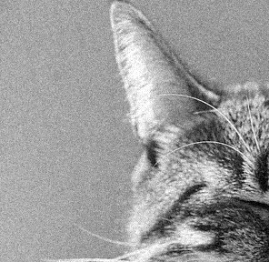
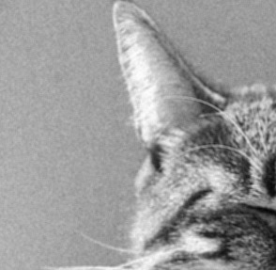
Noise reduction using mean filtering

Slide 27
Cross-correlation
1 | 2 | 3
4 | 5 | 6
7 | 8 | 9
1 | 2 | 3
4 | 5 | 6
7 | 8 | 9
w
f
1*1 + 2*2 + 3*3 + 4*4 + 5*5 + 6*6 + 7*7 + 8*8 + 9*9

Slide 28
Convolution
1 | 2 | 3
4 | 5 | 6
7 | 8 | 9
1 | 2 | 3
4 | 5 | 6
7 | 8 | 9
w
f
1*9 + 2*8 + 3*7 + 4*6 + 5*5 + 6*4 + 7*3 + 8*2 + 9*1

Slide 29
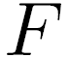
Convolution
Adapted from F. Durand

Slide 30
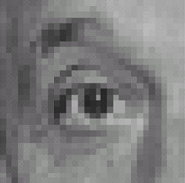
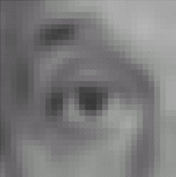

Filters: examples
*
1
1
1
=
1
1
1
1
1
1
Kernel (k)
Original (f)
Blur (with a mean filter) (g)
Source: D. Lowe

Slide 31
Filters: examples
*
0
0
0
=
0
1
0
0
0
0
Kernel (k)
Original (f)
Identical image (g)
Source: D. Lowe

Slide 32
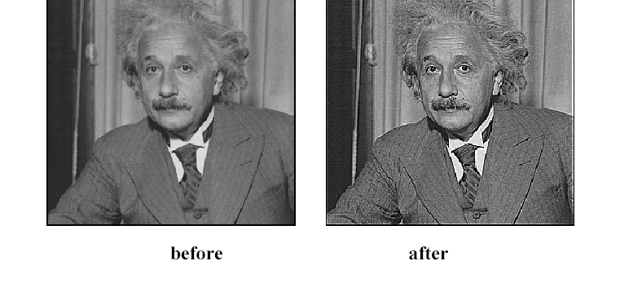
Sharpening
Source: D. Lowe

Slide 33
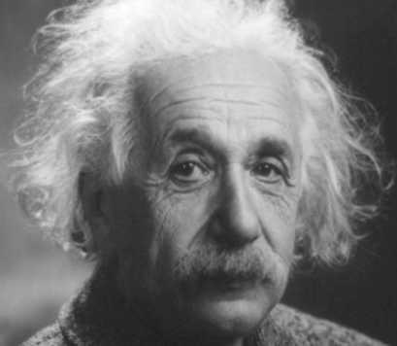
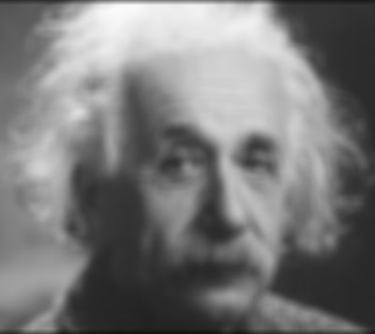
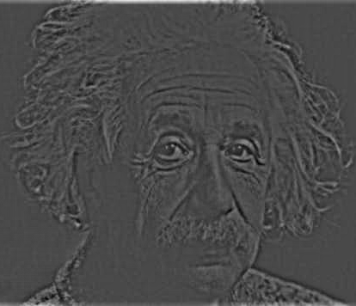
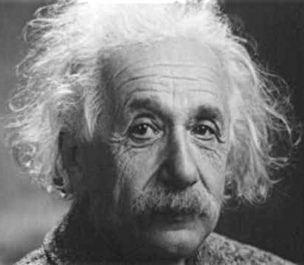
Sharpening
What does blurring take away?
–
=
Let’s add it back:
+ α
=
original
detail

Slide 34
Sharpening

Slide 35
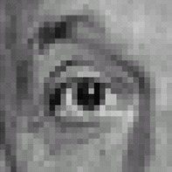



Sharpening filter
*
0
0
0
-
1
1
1
=
0
2
0
1
1
1
0
0
0
1
1
1
Sharpening filter (accentuates edges)
Original
Source: D. Lowe

Slide 36
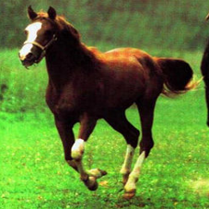
Convolution is everywhere
Horse

Slide 37
Why is convolution important?
We like linearity
Linear functions behave predictably when input changes
Lots of theory just easier with linear functions
All linear shift-invariant systems can be expressed as a convolution

Slide 38
Non-linear filters
Sometimes mean filtering does not work

Slide 39
Non-linear filters
Sometimes mean filtering does not work

Slide 40
Non-linear filters
Mean is sensitive to outliers
Median filter: Replace pixel by median of neighbors

Slide 41
Non-linear filters

Slide 42
Takeaway
Two general recipes:
convolution
cross-correlation
Properties
Shift-invariant: a sensible thing to require
Linearity: convenient
Can be used for smoothing, sharpening
Also main component of CNNs

Slide 43
Low pass filters (Smoothing) Low pass filtering, is employed to remove high spatial frequency noise from a digital image. The low-pass filters usually employ moving window operator which affects one pixel of the image at a time, changing its value by some function of a local region (window) of pixels. The operator moves over the image to affect all the pixels in the image.
High pass filters (Edge Detection, Sharpening) A high-pass filter can be used to make an image appear sharper. These filters emphasize fine details in the image - the opposite of the low-pass filter. High-pass filtering works in the same way as low-pass filtering; it just uses a different convolution kernel.

Slide 44
Moving average
Let’s replace each pixel with a weighted average of its neighborhood
The weights are called the filter kernel
What are the weights for the average of a 3x3 neighborhood?
1
1
1
1
1
1
1
1
1
“box filter”
Source: D. Lowe

Slide 45
Practice with linear filters
0
0
0
?
0
1
0
0
0
0
Original
Source: D. Lowe

Slide 46
Practice with linear filters
0
0
0
0
1
0
0
0
0
Original
Filtered
(no change)
Source: D. Lowe

Slide 47
Practice with linear filters
0
0
0
?
0
0
1
0
0
0
Original
Source: D. Lowe

Slide 48
Practice with linear filters
0
0
0
0
0
1
0
0
0
Original
Shifted left
By 1 pixel
Source: D. Lowe

Slide 49
Practice with linear filters
1
1
1
?
1
1
1
1
1
1
Original
Source: D. Lowe

Slide 50
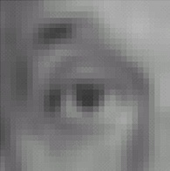
Practice with linear filters
1
1
1
1
1
1
1
1
1
Original
Blur (with a
box filter)
Source: D. Lowe

Slide 51

Practice with linear filters
0
0
0
-
1
1
1
?
0
2
0
1
1
1
0
0
0
1
1
1
(Note that filter sums to 1)
Original
Source: D. Lowe

Slide 52
Practice with linear filters
0
0
0
-
1
1
1
0
2
0
1
1
1
0
0
0
1
1
1
Original
Sharpening filter
Accentuates differences with local average
Source: D. Lowe

Slide 53
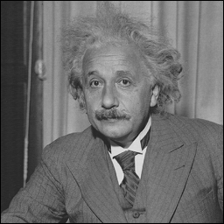
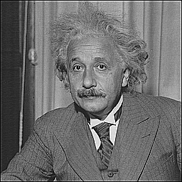
Sharpening
before
after
Slide credit: Bill Freeman

Slide 54
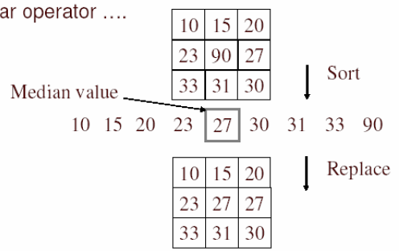
Alternative idea: Median filtering
A median filter operates over a window by selecting the median intensity in the window
Is median filtering linear?
Source: K. Grauman
Notes:
Linearity of median filter: try filter([0 0 0; 0 1 0; 0 0 0] + [1 1 1; 1 1 2; 2 2 2])

Slide 55
Median filter
Replace each pixel by the median over N pixels (5 pixels, for these examples). Generalizes to “rank order” filters.
Median([1 7 1 5 1]) = 1
Mean([1 7 1 5 1]) = 2.8
In:
Out:
Spike noise is removed
5-pixel neighborhood
Monotonic edges remain unchanged
In:
Out:

Slide 56
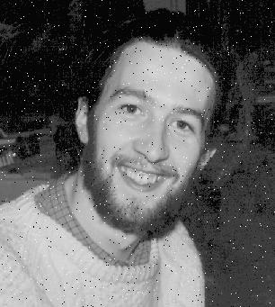

Median filtering results
Best for salt and pepper noise
http://homepages.inf.ed.ac.uk/rbf/HIPR2/mean.htm#guidelines

Slide 57
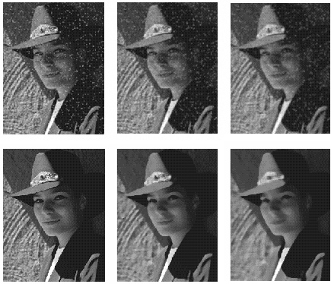
Median vs. Gaussian filtering
3x3
5x5
7x7
Gaussian
Median

Slide 58
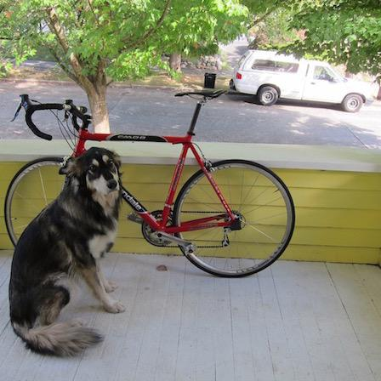
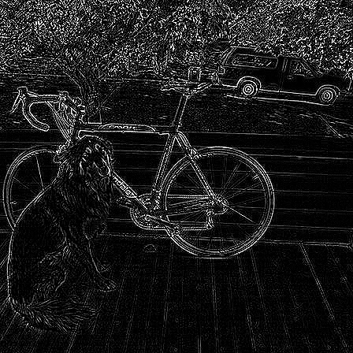
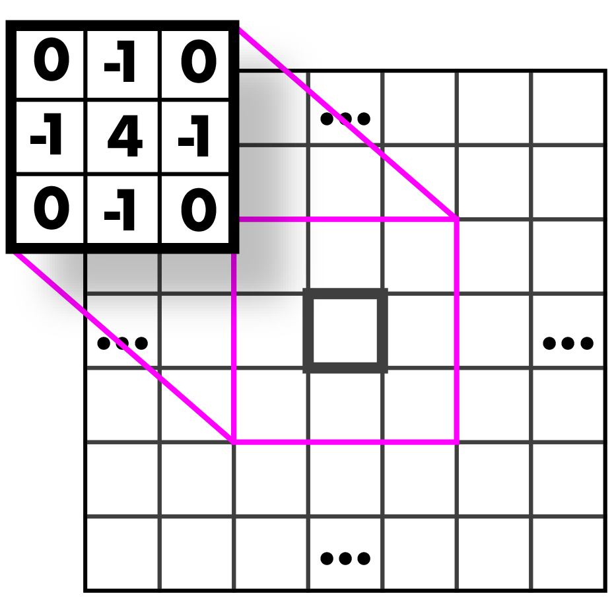
Highpass Kernel: finds edges (applied to the graytone image!)

Slide 59
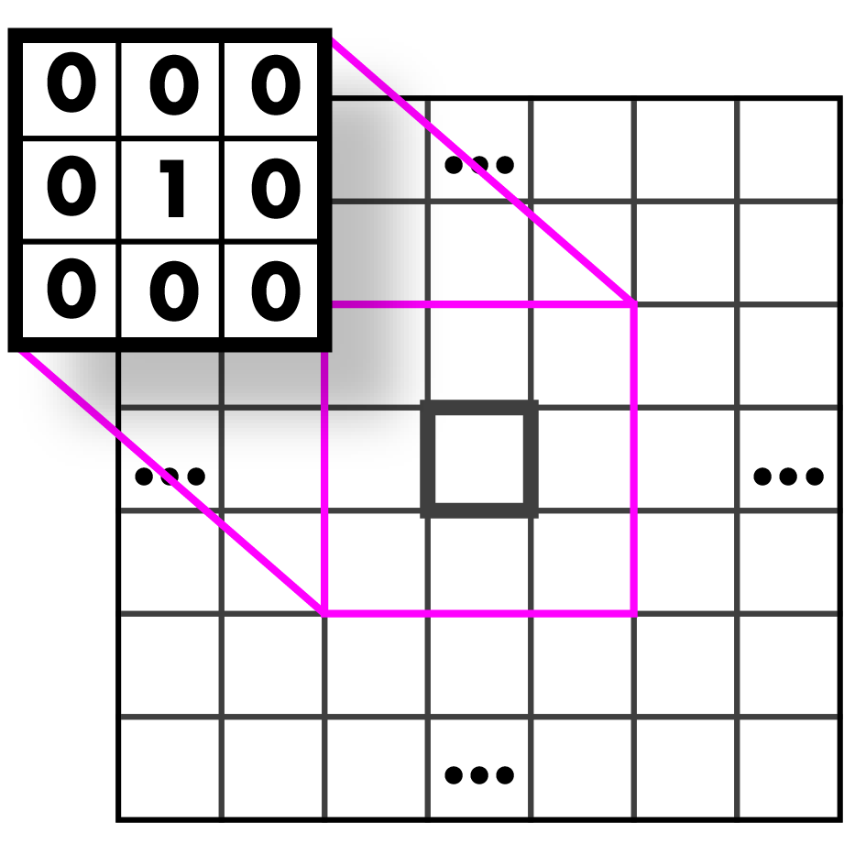
Guess that kernel!

Slide 60
Identity Kernel: Does nothing!

Slide 61

Guess that kernel!

Slide 62
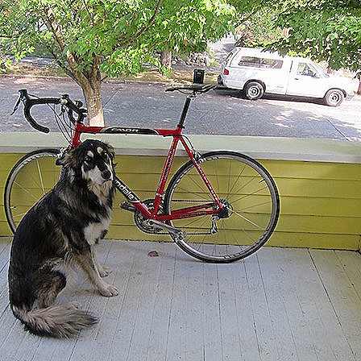
Sharpen Kernel: sharpens! (applied to all three bands)
Note: sharpen = highpass + identity!

Slide 63

Guess that kernel!

Slide 64
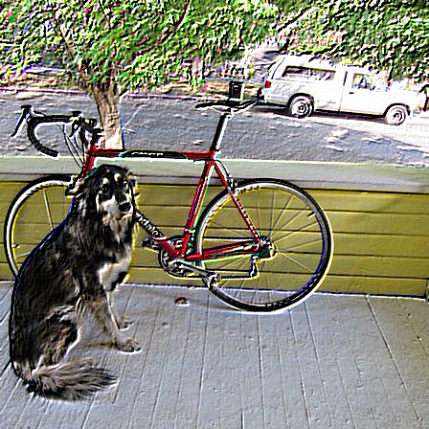
Emboss Kernel: stylin’ (applied to all three bands)

Slide 65
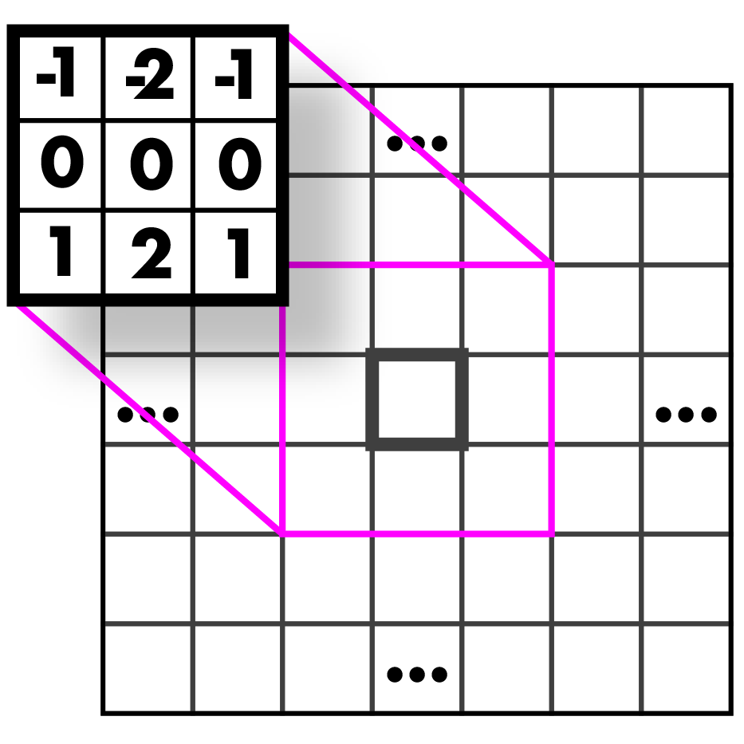

Guess those kernels!

Slide 66
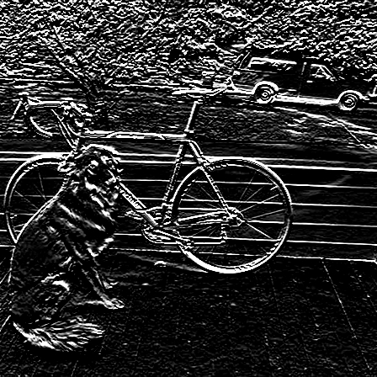
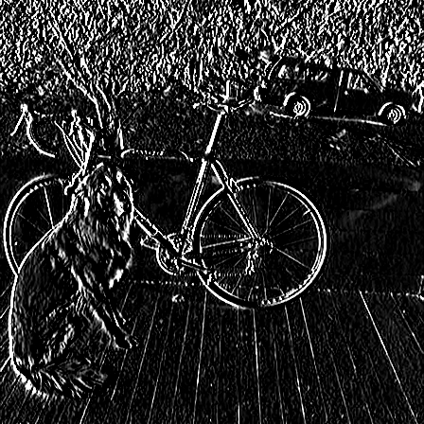
Sobel Kernels: edges (applied to a graytone image and thresholded)

Slide 67
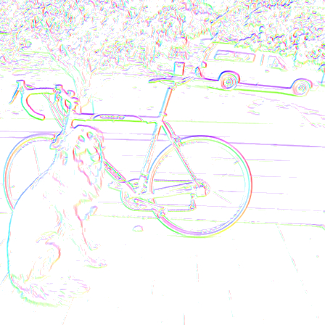
Sobel Kernels: edges and gradient!

Slide 68
Sobel Kernels: edges and gradient!
This visualization is showing the magnitude and direction of the gradient. We will talk further about this when we discuss edges.

Slide 69
And so much more!!

